Slide 1

Session Name:
Statistical Analysis with Python
Delivered By:
Vikash Singh

Slide 2

Learning Objectives
By the end of this session, you will be able to:
Understand analysis pipeline
Descriptive stats, hypothesis testing, visualization
Python tools: Pandas, Seaborn, Scipy
MCQs, Quizzes, Activities
Python Code for the analysis

Slide 3

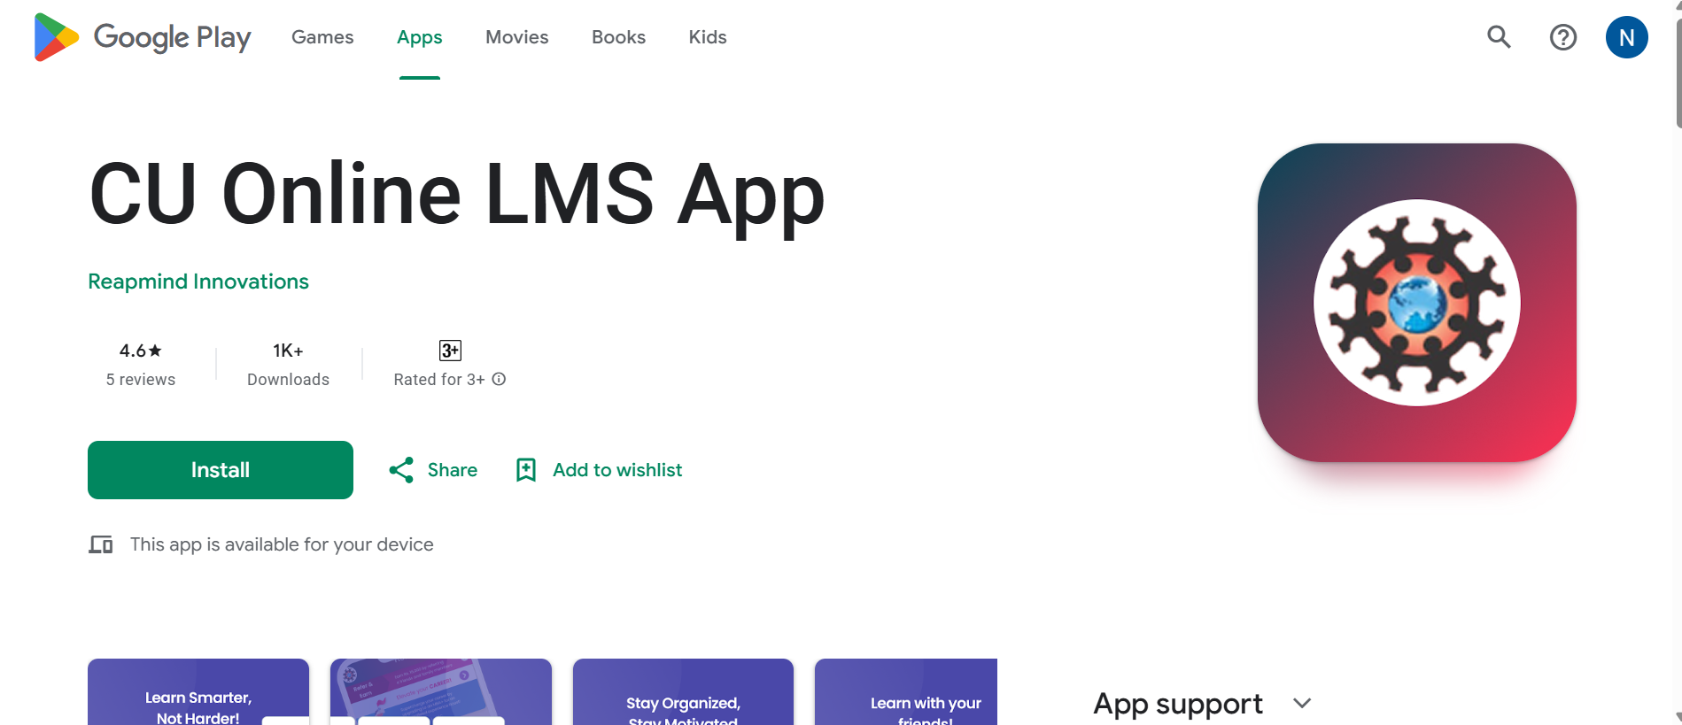
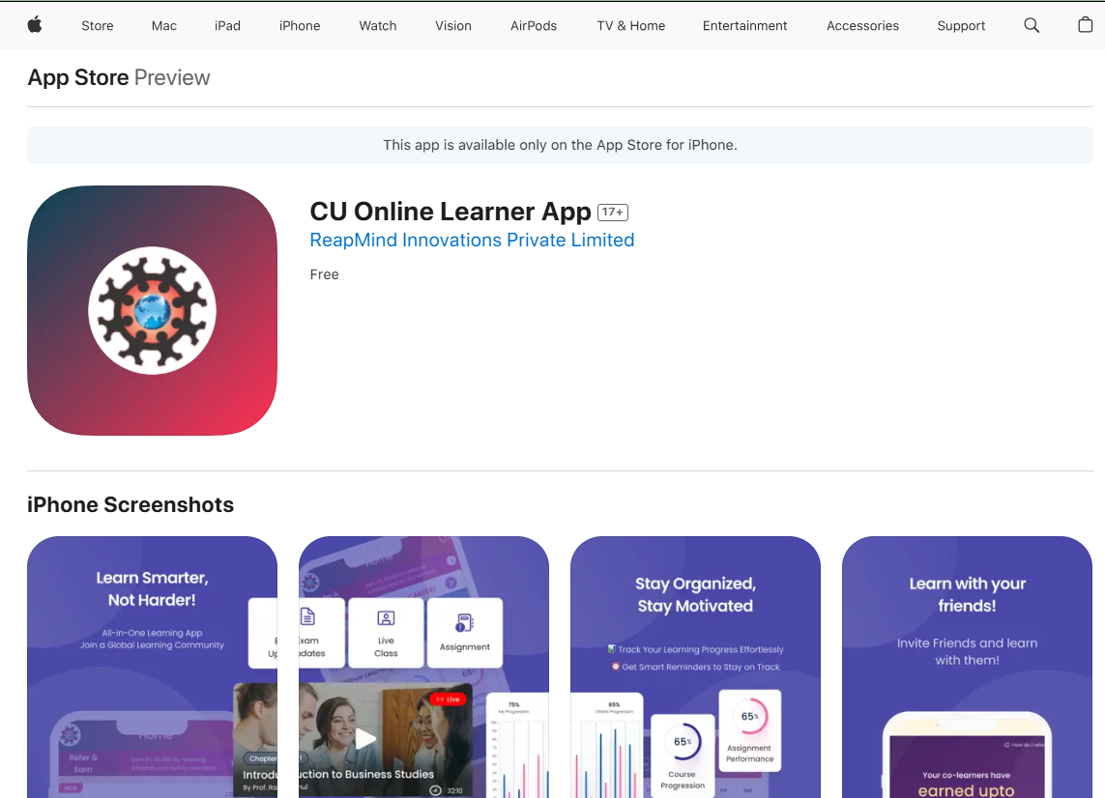
CU ONLINE LMS APP
For Android Users:
Open the Google Play Store on your device and search for "CU Online LMS App".
Tap the app from the search results and select Install.
Once installed, tap Open or locate the app on your home screen.
Log in using your LMS credentials.
👉 Download Now: Playstore Link
For IOS Users:
Open the Apple Play Store on your device and search for "CU Online LMS App".
Tap the app from the search results and select Install.
Once installed, tap Open or locate the app on your home screen.
Log in using your LMS credentials.
👉 Download Now: App Store Link

Slide 4
What is End-to-End Data Analysis?
Start from raw data
Clean, explore, analyze, visualize
Draw business/research conclusions

Slide 5
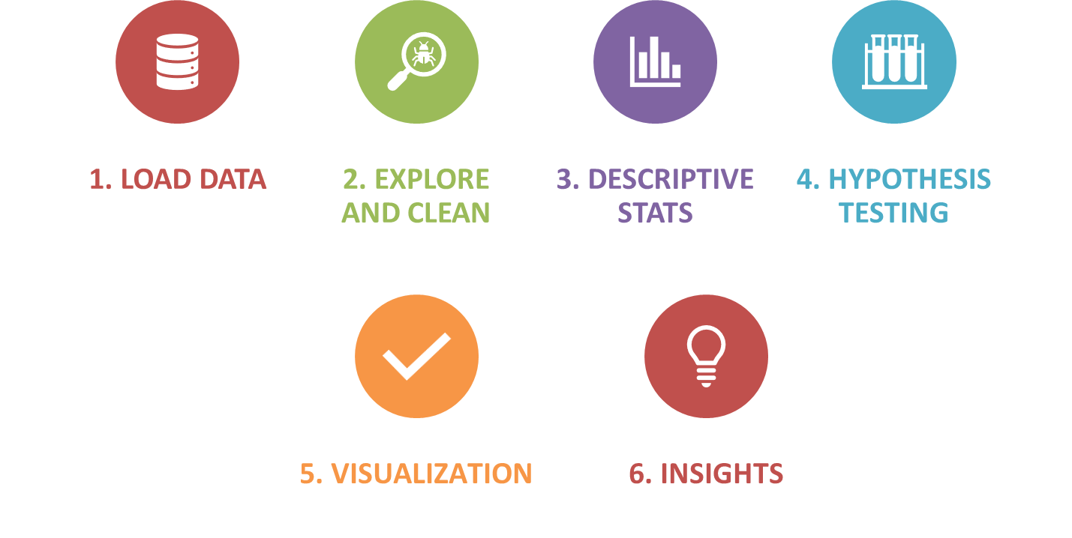
Analysis Pipeline Overview

Slide 6
Python notebook analysis

Slide 7
MCQ
What does `.describe()` function in pandas return?
A) Only column names B) Only missing values C) Summary statistics like mean, std, min, max D) Data types
2. Which Python library is typically used for hypothesis testing?
A) Pandas B) Seaborn C) Matplotlib D) Scipy

Slide 8
MCQ
What does `.describe()` function in pandas return?
A) Only column names B) Only missing values C) Summary statistics like mean, std, min, max ✅ D) Data types
2. Which Python library is typically used for hypothesis testing?
A) Pandas B) Seaborn C) Matplotlib D) Scipy ✅

Slide 9
MCQ
3. If the p-value is less than 0.05 in a t-test, what should we do?
A) Accept the null hypothesis B) Fail to reject the null hypothesis C) Reject the null hypothesis D) Increase the sample size
4. Which visualization is best to detect outliers?
A) Line plot B) Histogram C) Boxplot D) Bar chart

Slide 10
MCQ
3. If the p-value is less than 0.05 in a t-test, what should we do?
A) Accept the null hypothesis B) Fail to reject the null hypothesis C) Reject the null hypothesis ✅ D) Increase the sample size
4. Which visualization is best to detect outliers?
A) Line plot B) Histogram C) Boxplot ✅ D) Bar chart

Slide 11
Session Summary
In this session, we have discussed about:
Understand analysis pipeline
Descriptive stats, hypothesis testing, visualization
Python tools: Pandas, Seaborn, Scipy
MCQs, Quizzes, Activities
Python Code for the analysis

Slide 12
References
Connect on:
https://www.linkedin.com/in/vikashsingh29/

Slide 13

Happy Learning!

